Slide 1
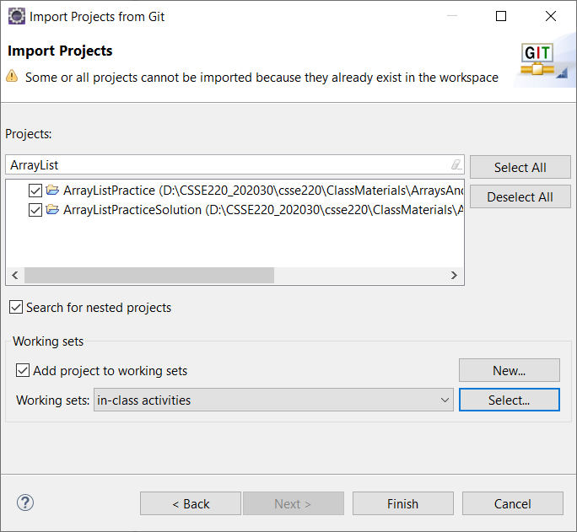
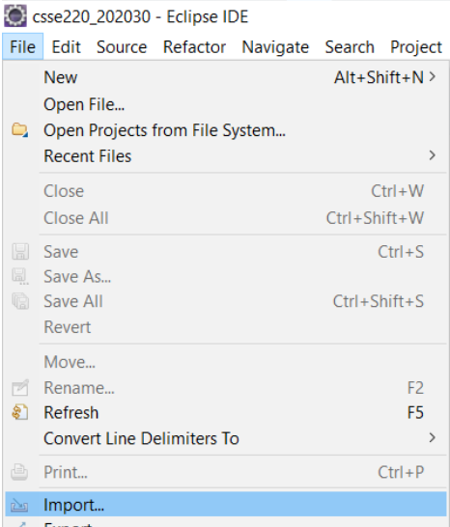
CSSE 220 – every class do this:
File->Import
Git->Projects from Git -> Next
Existing local repository -> Next
csse220 [master] ->Next
Import Existing Eclipse Projects->Next
**DESELECT ALL**
Search for repo name on slide:
Check projects for the day -> Finish
Import ArrayListPractice from Git repo
Notes:
Today’s quiz is in the last two pages of “03 Array Examples Handout.docx”
Attendance: roll call with First, Last name
Take picture of room

Slide 2
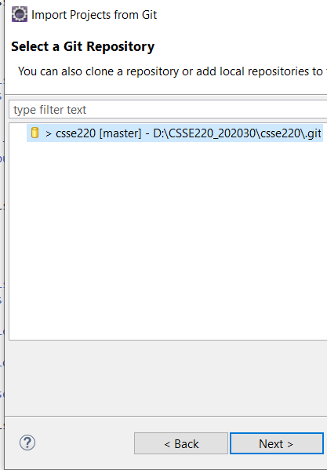
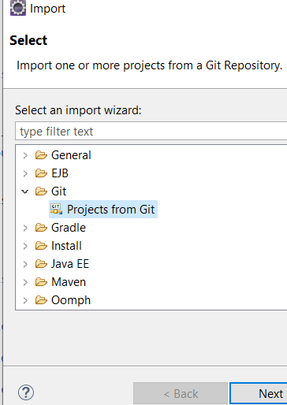
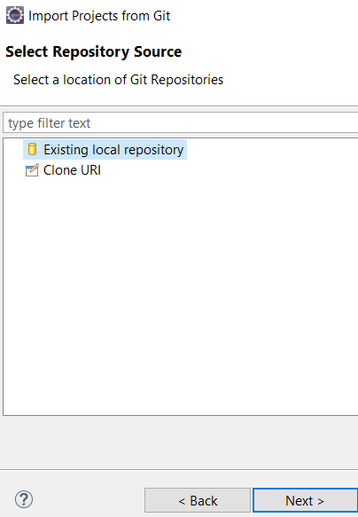
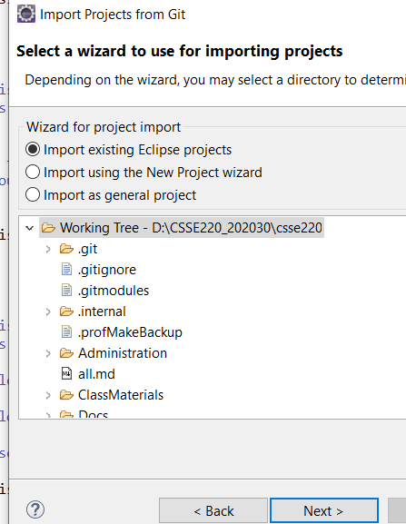
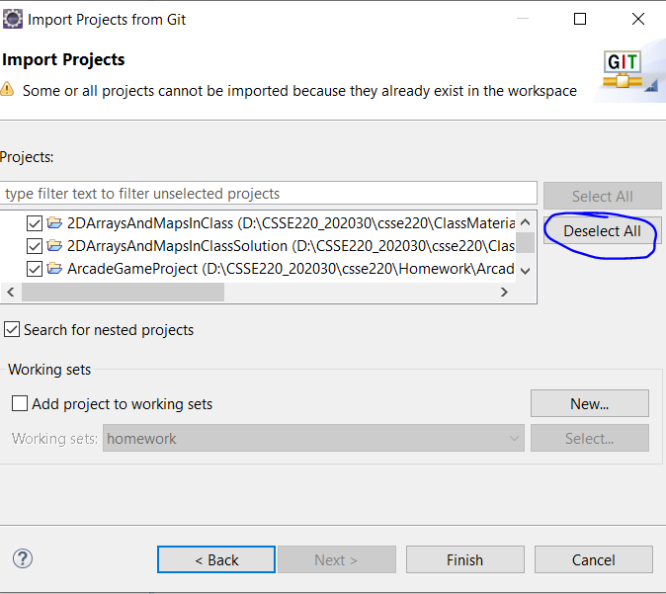
Screenshots

Slide 3
CSSE 220
Arrays
ArrayLists
Wrapper Classes
Auto-boxing
Enhanced for loop
Import ArrayListPractice from Git repo

Slide 4
Speed With Which Things Move
Moving up a level in speed
Anticipate:
Go through slides before class
Familiarize yourself with terminology
Read the Big Java chapters
Write down questions for instructor
Ask questions in class, or hand piece of paper with questions to instructor at beginning of class

Slide 5

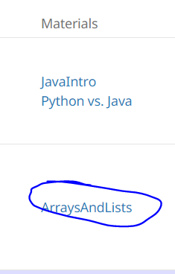
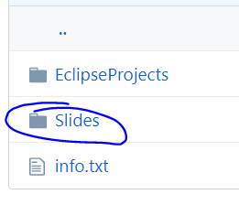
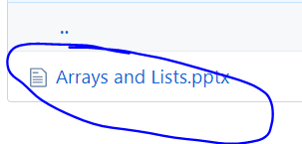
How to access slides (from online)

Slide 6
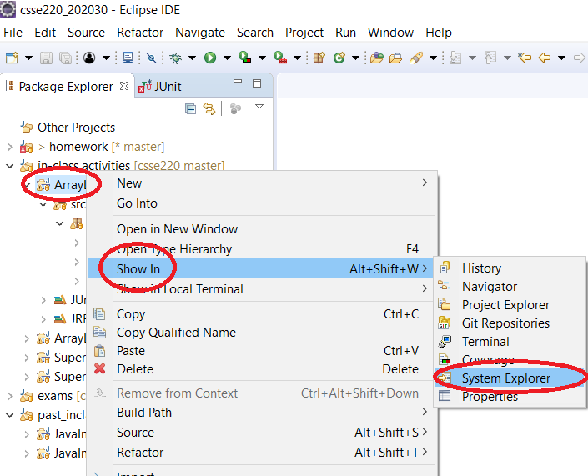
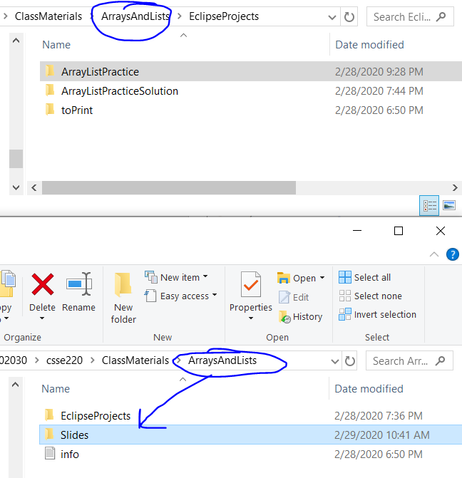
How to access slides (locally)

Slide 7
Getting things done
If something has a hard deadline, then set a reminder in your smart device
Live by: “if I don’t do it now, it won’t get done”
Speaking of which… HW1…
Notes:
Go over solution from HW1 to make sure students get the answer
intentionally introduce error in HW1 as you go. order of operations. different approaches.

Slide 8
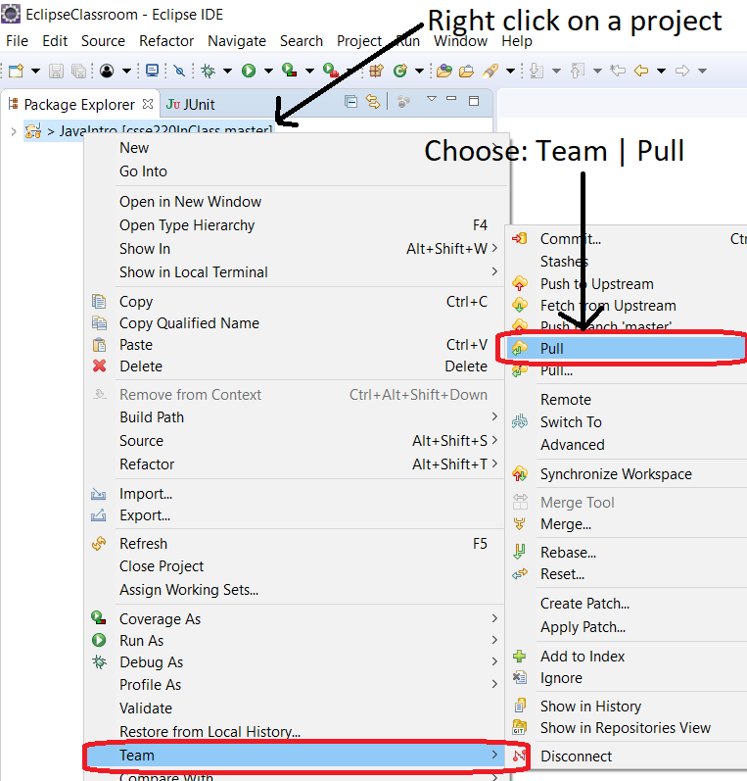
Pull Latest Version of Code
Team Pull

Slide 9
Review Loops: while & for Loops
While loop syntax: Similar to Python
while (condition) { statements
}
For loop syntax: Different from Python
for (init; condition ; update) { statements
}
In both cases, curly braces optional if only one statement in body; but be careful!
Notes:
Point students to Python vs Java features linked from session 1 of course schedule.

Slide 10
Comparing for vs. while
int k =0; ← extra line
while (k < 10) { System.out.println(k);
k++; ← extra line
} // end while
for (int k = 0 ; k < 10; k++) { System.out.println(k);
} // end for
Notes:
Notice stop conditions!

Slide 11
Important Reminder: Comparisons
Fast rules for now:
Use .equals() for comparing Strings
String alpha = “aaa”;
if (alpha.equals(“bbb”) {
System.out.println(“Yes!”)
} // end if
Use == comparing numbers or char (primitives)
boolean a = (5 == 6);
boolean b = (‘T’ == ‘F’ );

Slide 12
JavaIntro, HW1, TwelveProblems
Any questions: feel free to ask individually
JavaIntro will not be collected and graded
Intended to help you learn
Not intended as busy work
TwelveProblems
Due date on schedule page
First half you can probably do already
Notes:
Go over solution show that the * mark is present until update

Slide 13
Syllabus Highlights
Schedule: https://rhit-csse.github.io/csse220/schedule.html
Notes:
We give you the ability to run tests and determine whether you have the correct solution or not before you submit it!
We expect most of you to have a 95% plus grade for your homework average, you should have lots of opportunities to get help and do well.
Exams will be difficult and push you, so the activities in class and homework are designed to train you to be prepared to do well.
Exams will be similar to quizzes done in class- written and coding part.
Must have passing average on exams to pass course.
Must have a “C” to take 230! Need solid foundation.

Slide 14
Syllabus Highlights
Course policies: https://github.com/RHIT-CSSE/csse220/blob/master/Docs/course_policies.md
(Also on Schedule page, under the first day labeled “Syllabus”)
Late Assignments
Grading
Collegiality
Notes:
We give you the ability to run tests and determine whether you have the correct solution or not before you submit it!
We expect most of you to have a 95% plus grade for your homework average, you should have lots of opportunities to get help and do well.
Exams will be difficult and push you, so the activities in class and homework are designed to train you to be prepared to do well.
Exams will be similar to quizzes done in class- written and coding part.
Must have passing average on exams to pass course.
Must have a “C” to take 230! Need solid foundation.

Slide 15
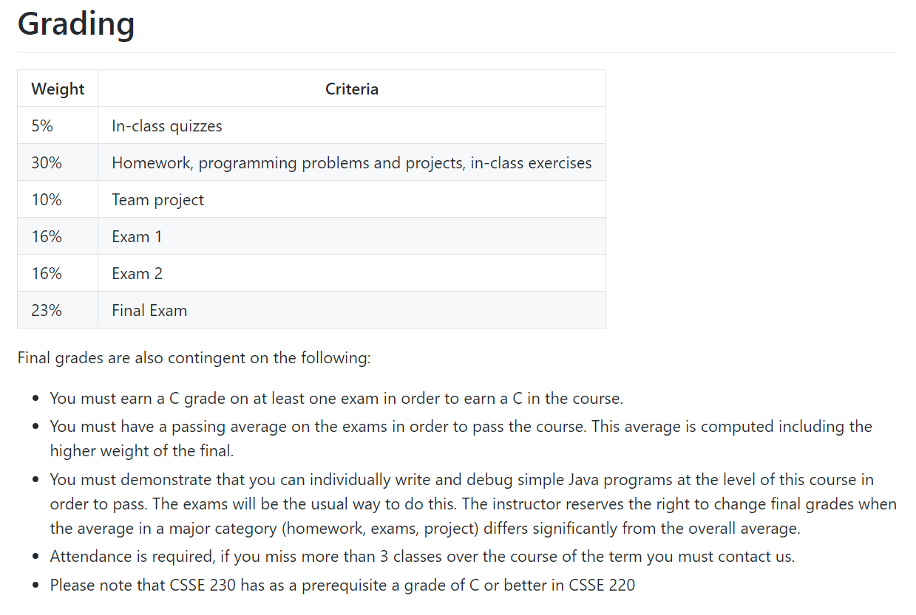
From Syllabus Page:

Slide 16
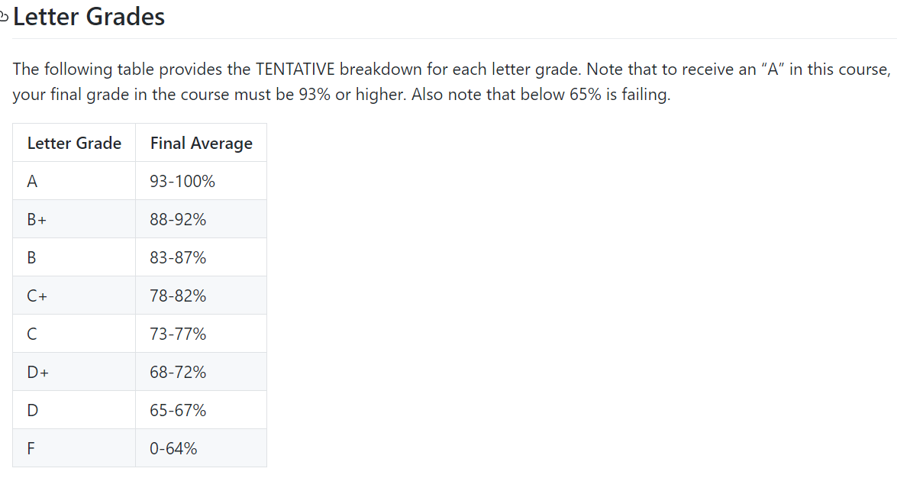
From Syllabus Page:

Slide 17
Review of types
Primitives
int, double, char, boolean, long, …
Objects
String, …
Gotchas:
What is 7/2?
Alternatives?
What is x/y if x and y are both ints?
Alternatives?
What is s after these 2 lines?
String s = “computer”;
s.substring(0,3);
Alternatives?
Notes:
Use / to intro typecasting
Use substring to talk about immutability of strings.

Slide 18
Arrays- What, When, Why, & How?
What
A special type used to hold a fixed number of items of a specified type
When
Use when you need to store multiple items of the same type
Number of items is known and will not change
Notes:
Every array is of a particular type, the SQUARE BRACKETS indicate that it is an array
Mention NEW: keyword! Grab MEMORY!
How to declare an array of 100 players?
Player[] players = new Player[100]; DOES NOT CREATE ANY PLAYERS, JUST SPACE
null is default value for Objects
Show indices 0-99
players[0] = new Player( some_info );
Try to get started by 25 minutes

Slide 19
Arrays- What, When, Why, & How?
Why
Avoids things like int1, int2, int3, int4
Avoids repetitive code and frequent updates
How
Type[] arr = new Type[num]; Creates a new array of type Type stored in variable arr
An array of 5 Strings (stored in the variable fiveStrings) would look like this: String[] fiveStrings = new String[5];

Slide 20
Array Examples Handout
Form groups of 2
Look at the Array Examples Handout Steps 1 – 3 of handout – Built-in Java Arrays
Study how arrays are used and answer the questions in the quiz: FIRST PAGE OF QUIZ ONLY
Step 3 of handout: http://codingbat.com/java/Array-2
Work in your groups to solve: fizArray3, bigDiff, shiftLeft
If you finish early, try: zeroFront
Save your codingbat work by copy and paste
Add to CodingBatPractice.java
At bell: we move on to ArrayLists Steps 4 – 7 of handout

Slide 21
Array Types
Group a collection of objects under a single name
Elements are referred to by their position, or index, in the collection (0, 1, 2, …)
Syntax for declaring: ElementType[] name
Declaration examples:
A local variable: double[ ] averages;
Parameters: public int max(int[] values) {…}
A field: private Investment[] mutualFunds;
Notes:
Note that the [] is part of type name, not after the variable name. Easy to understand for many people.

Slide 22
Allocating Arrays
Syntax for allocating: new ElementType[length]
Creates space to hold values
Java automatically sets values to defaults
0 for number types
false for boolean type
null for object types
Examples:
double[] polls = new double[50];
int[] elecVotes = new int[50];
Dog[] dogs = new Dog[50];
Don’t forget this step!
This does NOT construct any Dogs. It just allocates space for referring to Dogs (all the Dogs start out as null )
Notes:
Draw pictures on board for examples.
new Dog[50] creates 50 Dog “kennels”, we still have to put the dogs in them!
Draw out diagram on board showing indices
[ ] [ ] [ ] [ ] [ ]
0 1 2 3 4

Slide 23


Dog[] dogs = new Dog[10];
This does NOT construct any Dogs. It just allocates space for referring to Dogs (all the Dogs start out as null )
null
Dogs[0] = new Dog();
This does construct ONE Dog and places it in the first position of the array (first kennel).

Slide 24
Reading and Writing Array Elements
Reading:
double exp = polls[42] * elecVotes[42];
Writing:
elecVotes[37] = 11;
Index numbers run from 0 to array length – 1
Getting array length: elecVotes.length
Sets the value in slot 37.
Accesses the element with index 42.
No parentheses, array length is (like) a field

Slide 25
Arrays: Comparison Shopping
Arrays… | Java | Python lists
have fixed length | yes | no
are initialized to default values | yes | n/a
track their own length | yes | yes
trying to access “out of bounds” stops program before worse things happen | yes | yes
Notes:
The n/a is because Python arrays are either initially empty or the elements are given at the time of creation.

Slide 26
ArrayList- What, When, Why, & How?
What
A class in a Java library used to hold a collection of items of a specified type
Allows variable number of items
Fast random access
When
Use when you need to store multiple items of the same type
Number of items is not known/will change
Notes:
Imagine team with 100 players go to add one more, have to construct total new array and copy all the data
ArrayList class takes care of everything -> Data Structures class lets you see how this is done efficiently

Slide 27
ArrayList- What, When, Why, & How?
Why
Fast random access
Allows length changes, cannot do this with an array
How
ArrayList<Type> arl = new ArrayList<Type>();
Creates a new ArrayList of type Type stored in variable arl
Notes:
NO SQUARE BRACKETS – SQUARE BRACKETS indicate FIXED size
Angled brackets – generic, will discuss more later
Translate example of Player[] players
ArrayList<Player> players = new ArrayList<Player>();
ArrayList<Player> players = new ArrayList(); Java 7+ optional
players.add( new Player( ____ ) ); //adds to the end! .add( index, Object)
players.get( 0 );
.remove( index );
.set( index, player ); //overwrite

Slide 28
ArrayList Examples Handout
Look at the ArrayList section of the examples handout
Study how ArrayLists are used and answer the questions in the quiz (page 2)
Then solve the 3 problems in ArrayListPractice (you downloaded it from Git)
Notes:
Priorities in class
#1 get Quiz done
#2 ArrayList Example problems in SVN
#3 TwelveProblems

Slide 29
What if we don’t know how many elements there will be?
ArrayLists to the rescue
Example:
ArrayList<State> states = new ArrayList<State>();
states.add(new State(“Indiana”, 11, .484, .497));
ArrayList is a generic class
Type in <brackets> is called a type parameter
Optional in Java 7 and onwards
Element type
e.g., new ArrayList<>()
Variable type
Constructs new, empty list
Adds new element to end of list
Notes:
[Bullets and call-outs animated]
Q: Type parameters in generic class let us tell Java what types to allow in a “container” so it can catch mistakes for us.

Slide 30
ArrayList Gotchas
Type parameter cannot be a primitive type
Not: ArrayList<int> runs;
But: ArrayList<Integer> runs;
Use get method to access elements
Not: runs[12]
But: runs.get(12)
Use size() not length
Not: runs.length
But: runs.size()
Notes:
More on primitive types and ArrayLists soon!

Slide 31

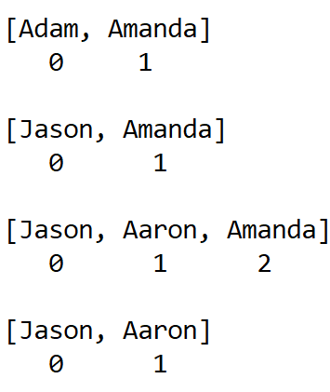
Lots of Ways to Add to List
Example List:
ArrayList<String> names =
new ArrayList<String>();
Add to end:
names.add("Adam");
names.add(“Amanda");
Overwrite existing element:
names.set(0,"Jason");
Insert in the middle:
names.add(1,"Aaron");
Pushes elements at indexes 1
and higher up one
Can also remove:
names.remove( names.size() - 1);
this removes at the end

Slide 32
So, what’s the deal with primitive types?
Problem:
ArrayList’s only hold objects
Primitive types aren’t objects
Solution:
Wrapper classes—instances are used to “turn” primitive types into objects
Primitive value is stored in a field inside the object
Primitive | Wrapper
byte | Byte
boolean | Boolean
char | Character
double | Double
float | Float
int | Integer
long | Long
short | Short
Notes:
Note strange cases. Why? Perhaps the Java library designers were on crack?
Cannot do:
ArrayList< int > must be a class!!!! ArrayList<Integer>

Slide 33
Auto-boxing Makes Wrappers Easy
Auto-boxing: automatically enclosing a primitive type in a wrapper object when needed
Example:
You write: Integer m = 6;
Java does: Integer m = new Integer(6);
You write: Integer answer = m * 7;
Java does: int temp = m.intValue() * 7; Integer answer = new Integer(temp);
Notes:
Example bullet animated
Draw box and pointer diagrams on board for what Java does.

Slide 34
Auto-boxing Lets Us Use ArrayLists with Primitive Types
Remember to use wrapper class for array list element type
Example:
ArrayList<Integer> runs = new ArrayList<Integer>();
runs.add(9); // 9 is auto-boxed
int r = runs.get(0); // result is unboxed

Slide 35
Enhanced For Loop and Arrays
Old school double[] scores = … double sum = 0.0; for (int k = 0; k < scores.length; k++) { sum += scores[k]; }
New, whiz-bang, enhanced for loop double[] scores = … double sum = 0.0; for (double score : scores) { sum += score; }
No index variable (easy, but limited in 2 respects)
Gives a name (score here) to each element
Say “in”
Notes:
Call-outs animated
Like python’s “for num in nums:”
Convenient when we just need to iterate over the objects.
The two limitations:
We CAN’T USE the indices.
We CAN’T MODIFY the element and stick it back in the array.

Slide 36
Enhanced For and ArrayList’s
ArrayList<State> states = … int total = 0; for (State state : states) {
total += state.getElectoralVotes(); }

Slide 37
Understanding enhanced for loop with iterators
Enhanced for loop is effectively using something like this:
…scores (some grouping of doubles) double sum = 0.0;
Iterator iter = scores.iterator();
while ( iter.hasNext() ) {
double score = iter.next();
sum += score;
}
Notes:
Optional Slide to show what happens conceptually with an iterator
(helps make sense of the way it can work to the students)

Slide 38
Arrays vs. ArrayList: Coding
Action | Array | ArrayList
Declare Variable | int[] array; //null | ArrayList<Integer> arrList; //null
Assign Variable | array = new int[2]; //permanent capacity 2 | arrList = new ArrayList<Integer>(); //dynamic capacity
Add 5 to 1st position | array[0] = 5; | arrList.add(5); //add to end of list (empty) (1st spot, index 0)
Add 10 to 2nd position | array[1] = 10; | arrList.add(10); //add to end of list (2nd spot, index 1)
Print 1st value | System.out.println(array[0]); | System.out.println( arrList.get(0));

Slide 39
Work Time
Finish all the in-class material exercises if you haven’t yet
Work on TwelveProblems
Notes:
As time allows:
1. See if anyone is asking about static, give simple explanation
2. Possible elaborate on an auto-boxing diagram

